Slide 1


Parent Online Payments using
Westpac QuickWeb
Schools Finance
October 2014
Notes:
This presentation is designed for use at parent or school community meetings prior to the introduction of Parent Online Payments.
Emphasise the importance of the information in Slide 6 – Payment description. The school will advise parents what the enter here, if parents are unsure they should contact the school prior to making the payment. This will make receipting in OASIS straightforward.
Parents can still pay in the usual method i.e. cash, cheques or eftpos if your school has that facility.
This system is not meant to replace any of those, it is just another option for parents, although you may find that cash is being replaced by online payments.
This is much more secure than parents entering credit card details on the back of envelopes for schools to rekey and then be responsible for the secure destruction of the hand written details.

Slide 2
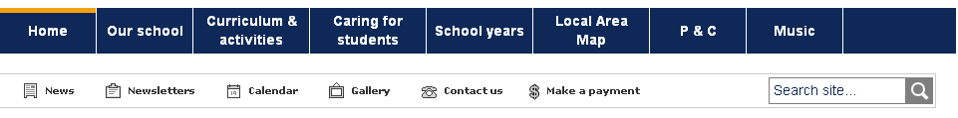
What is QuickWeb?
Secure online payment facility hosted by Westpac
Accessed from the home page of the school’s website
$Make a payment “button”
Notes:
The button may not be in the same place as the diagram above if your school manages their own website or it is managed by a third party.

Slide 3

Visa or MasterCard credit or debit cards only accepted
Notes:
PayPal and Bpay are not suitable for schools. These will only allow you to a pay one amount, the school will not always have clarity at to what item you are paying for.
You should not deposit directly into the school bank account as only limited text will appear on the school’s bank statement and the school will not always have clarity of what or who you are paying for.
The only EFTPOS cards are accepted are those that have a Visa or MasterCard logo.

Slide 4
4 Westpac QuickWeb pages
Entering payment details
Entering credit card details
Confirmation of payment details and
Online Payment Receipt.
Notes:
Go through each of the next 4 slides to explain each of the above.

Slide 5
Entering payment details
Student’s name, class or year, date of birth
Payer’s name, contact phone & email
Select what you want to pay for by checking relevant box
Payment description must be accurate
Payment amount must be completed
Asterix * indicates a mandatory field
Notes:
Anything with an * asterix is mandatory, if it is not filled in correctly you will get an error message and the payment will not proceed until the data is corrected.
Emphasise why you need the students name, class/year and date of birth.
Discuss Student Registration Numbers and invoice or reference numbers – you school may or may not use them - they are optional.

Slide 6
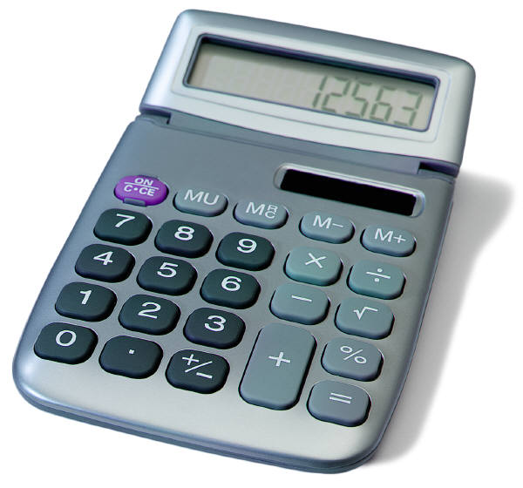

Payment description
Voluntary Schools Contributions – enter voluntary contribution
Subject Contributions – enter particular subject eg Maths
Excursion – enter name of excursion eg Opera House
Sport – enter name of particular sport eg Softball
Creative & Practical Arts – enter particulars eg Dance, Drama
Sales to Students – enter item you are purchasing eg calculator
Other – can be used to pay whole amount eg Term 1 2015
Notes:
Clarify the need for accuracy in the payment description boxes.
In excursion do not type in excursion, type in the name of the excursion eg Zoo
Use Other if paying making a whole term payment. You will not then choose the individual items from the list above Other.
Limits:
Voluntary School Contributions – only 1
Subject Contributions – up to 10
Excursions, Sport, Creative & Practical Arts, Sales to Students and Other – up to 5 of each

Slide 7
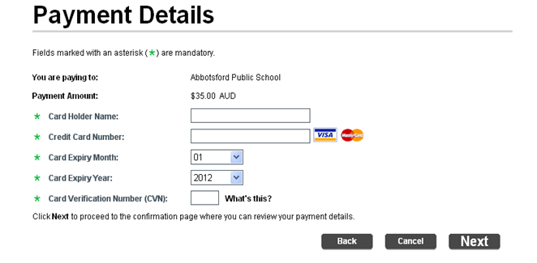
Entering credit/debit card details
Notes:
Same as most other payment systems.

Slide 8
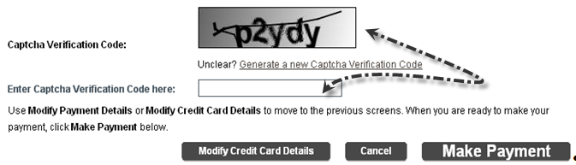
Confirm payment details
You can modify your credit card details or enter the Captcha code (security feature) and make the payment
Notes:
If the Captcha code is difficult to read, select Generate a new Captcha Verification Code. This is a security feature that protects the credit card holder.
You can modify the credit card details or cancel the payment at this point, or you can proceed and make the payment.

Slide 9
Online payment receipt
Print and/or Email – you can change the prefilled email address if you wish
Note the receipt number for your reference, and write this on any permission notes you are sending back to school.
You do not need to send a copy of your receipt to the school
Notes:
The school will not issue a receipt.
If a payment has been made in error, or the school needs to process a refund then this refund will go back to the card that was used for the payment.
Contact the school if this is the case.
Permission notes are still required, payment does not constitute permission.

Slide 10


More than one student to pay for?
Select Make Another Payment to pay for additional students
Notes:
Choose Make Another Payment to pay for additional students. This allows you to enter the student’s name, class/year and date of birth so there is no confusion at the school as to which student the payment applies to.

Slide 11
Timing
The payment must be made before 6pm for the school to receive the funds the next day. i.e. pay before 6pm on Monday, the school will have the funds on Tuesday morning.
If the payment is after 6pm then there will be a 24 hour delay in the school receiving the funds i.e. pay after 6pm on Monday, the school will have the funds on Wednesday morning.
Notes:
The school receives a report from Westpac every day to enable them to process the receipts to the student’s account.

